Slide 1
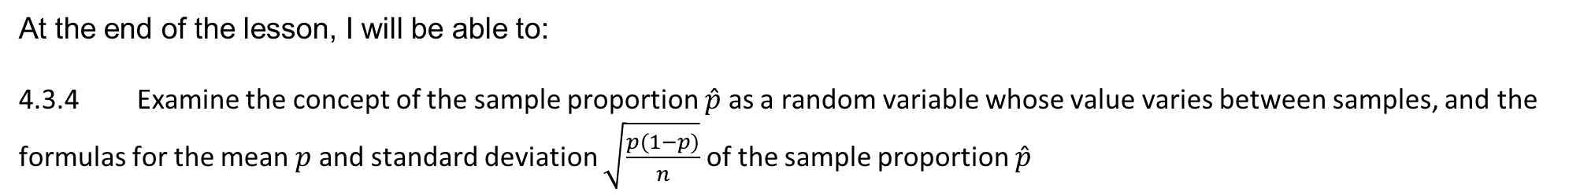
Learning Objective
I will be able to apply the concept of sample proportion to distribution
Success Criteria
At the end of the lesson, I will be able to:
4.3.4 Examine the concept of the sample proportion 𝑝̂ as a random variable whose value varies between samples, and the formulas for the mean 𝑝 and standard deviation $\sqrt{\frac{p(1−p)}{n}}$ of the sample proportion 𝑝̂

Slide 2
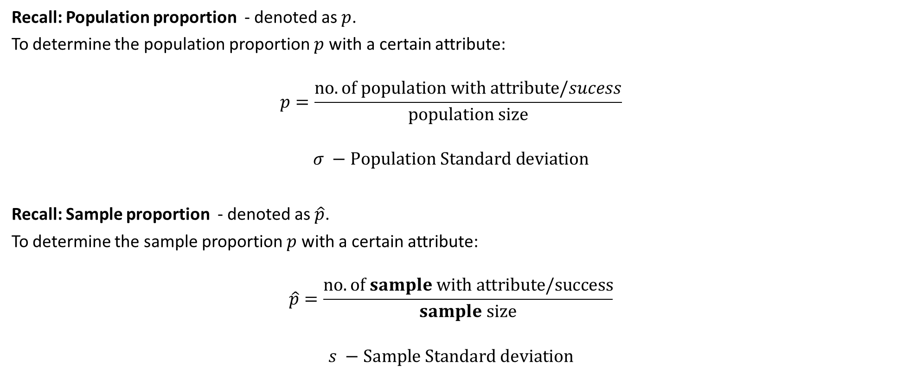
Recall: Sample Proportion
Recall: Population proportion - denoted as $p$.
To determine the population proportion $p$ with a certain attribute:
$$p=\frac{no. of population with attribute/sucess}{population size}$$
$$σ −Population Standard deviation$$
Recall: Sample proportion - denoted as $\hat{p}$.
To determine the sample proportion $p$ with a certain attribute:
$$\hat{p}=\frac{no. of sample with attribute/success}{sample size}$$
$$s −Sample Standard deviation$$

Slide 3
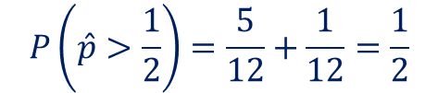
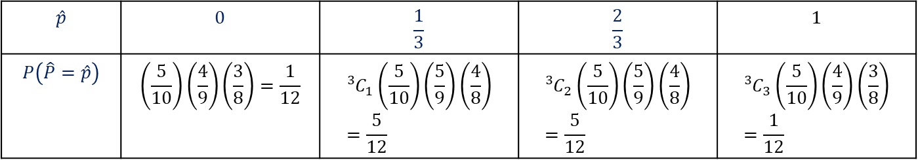
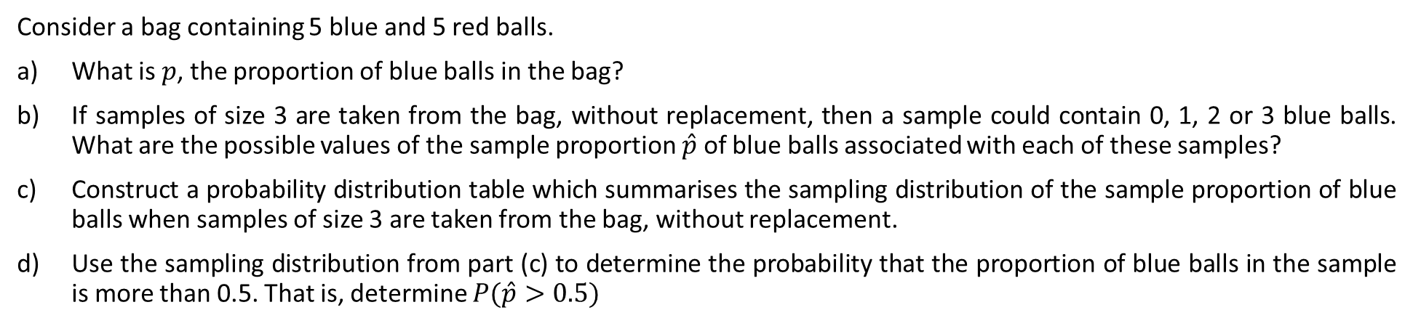
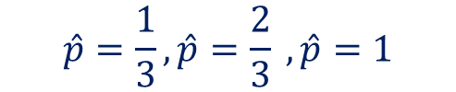
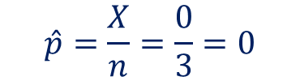

Guided Practice
Consider a bag containing 5 blue and 5 red balls.
What is $p$, the proportion of blue balls in the bag?
If samples of size 3 are taken from the bag, without replacement, then a sample could contain 0, 1, 2 or 3 blue balls. What are the possible values of the sample proportion $\hat{p}$ of blue balls associated with each of these samples?
Construct a probability distribution table which summarises the sampling distribution of the sample proportion of blue balls when samples of size 3 are taken from the bag, without replacement.
Use the sampling distribution from part (c) to determine the probability that the proportion of blue balls in the sample is more than 0.5. That is, determine $P(\hat{p}>0.5)$
a) Population proportion: $p=0.5$
b) $X=0, 1, 2, 3$ and $n=3$
$$\hat{p}$$ | $$0$$ | $$\frac{1}{3}$$ | $$\frac{2}{3}$$ | $$1$$
$$P\left(\hat{P}=\hat{p}\right)$$ | $$\left(\frac{5}{10}\right)\left(\frac{4}{9}\right)\left(\frac{3}{8}\right)=\frac{1}{12}$$ | $${{}_{ }^{3}C}_{1}\left(\frac{5}{10}\right)\left(\frac{5}{9}\right)\left(\frac{4}{8}\right)=\frac{5}{12}$$ | $${{}_{ }^{3}C}_{2}\left(\frac{5}{10}\right)\left(\frac{5}{9}\right)\left(\frac{4}{8}\right)=\frac{5}{12}$$ | $${{}_{ }^{3}C}_{3}\left(\frac{5}{10}\right)\left(\frac{4}{9}\right)\left(\frac{3}{8}\right)=\frac{1}{12}$$
$$\hat{p}=\frac{X}{n}=\frac{0}{3}=0$$
$$\hat{p}=\frac{1}{3},\hat{p}=\frac{2}{3} ,\hat{p}=1$$
$$P\left(\hat{p}>\frac{1}{2}\right)=\frac{5}{12}+\frac{1}{12}=\frac{1}{2}$$

Slide 4
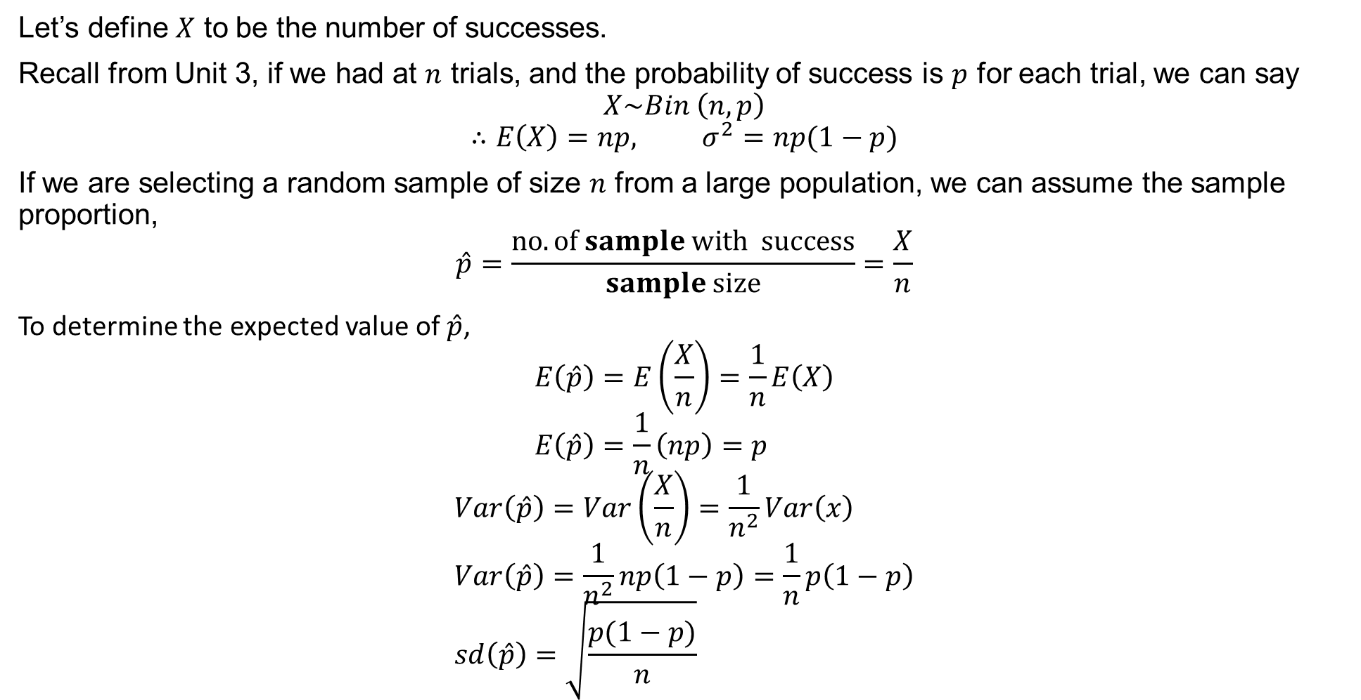
Distribution of Sample Proportion
Let’s define $X$ to be the number of successes.
Recall from Unit 3, if we had at $n$ trials, and the probability of success is $p$ for each trial, we can say
$$X\sim Bin \left(n,p\right)$$
$$∴E\left(X\right)=np, σ^{2}=np(1−p)$$
If we are selecting a random sample of size $n$ from a large population, we can assume the sample proportion,
$$\hat{p}=\frac{no. of sample with success}{sample size}=\frac{X}{n}$$
To determine the expected value of $\hat{p}$,
$$E\left(\hat{p}\right)=E\left(\frac{X}{n}\right)=\frac{1}{n}E\left(X\right) \\ E\left(\hat{p}\right)=\frac{1}{n}\left(np\right)=p$$
$$Var\left(\hat{p}\right)=Var\left(\frac{X}{n}\right)=\frac{1}{n^{2}}Var\left(x\right) \\ Var\left(\hat{p}\right)=\frac{1}{n^{2}}np\left(1−p\right)=\frac{1}{n}p\left(1−p\right) \\ sd\left(\hat{p}\right)=\sqrt{\frac{p(1−p)}{n}}$$

Slide 5

Sample Distribution
In summary,
If the population proportion (or probability) of some attribute is $p$, then for samples of size $n$ items we have $$E\left(\hat{p}\right)=p$$
$$Var\left(\hat{p}\right)=\frac{1}{n}p\left(1−p\right)$$
$$sd\left(\hat{p}\right)=\sqrt{\frac{p(1−p)}{n}}$$
Note: As $n→∞$, $Var\left(\hat{p}\right)→0$ and $\hat{p}$ (the sample proportion) will tend to $p$ the population proportion.

Slide 6
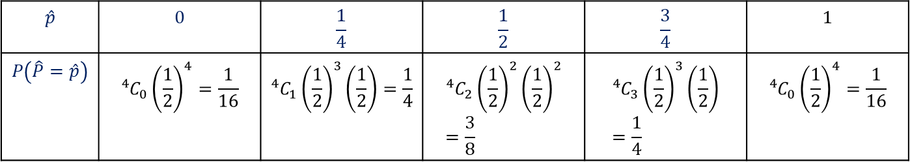
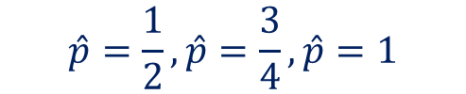
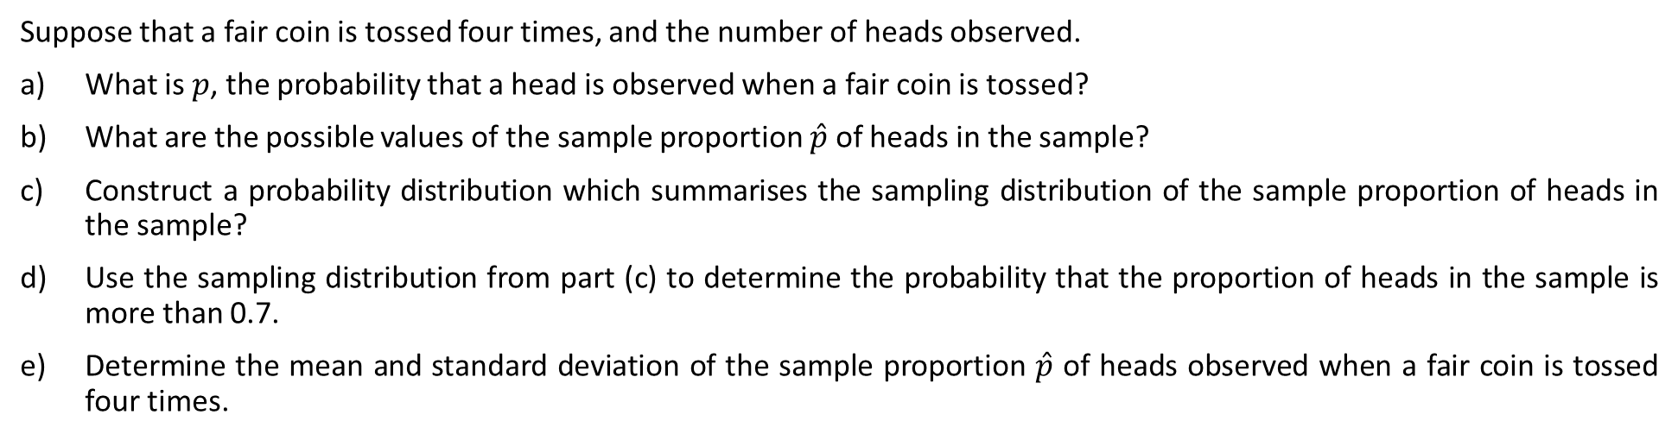
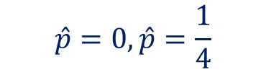

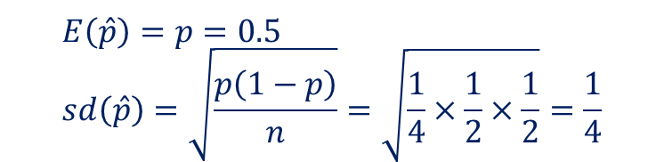

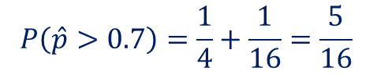
Guided Practice
Suppose that a fair coin is tossed four times, and the number of heads observed.
What is $p$, the probability that a head is observed when a fair coin is tossed?
What are the possible values of the sample proportion $\hat{p}$ of heads in the sample?
Construct a probability distribution which summarises the sampling distribution of the sample proportion of heads in the sample?
Use the sampling distribution from part (c) to determine the probability that the proportion of heads in the sample is more than 0.7.
Determine the mean and standard deviation of the sample proportion $\hat{p}$ of heads observed when a fair coin is tossed four times.
Consider the theoretical probability as the Population proportion: $p=0.5$
$$\hat{p}=\frac{X}{n}$$
$$\hat{p}$$ | $$0$$ | $$\frac{1}{4}$$ | $$\frac{1}{2}$$ | $$\frac{3}{4}$$ | $$1$$
$$P\left(\hat{P}=\hat{p}\right)$$ | $${{}_{ }^{4}{C_{0}}\left(\frac{1}{2}\right)}^{4}=\frac{1}{16}$$ | $${{}_{ }^{4}{C_{1}}\left(\frac{1}{2}\right)}^{3}\left(\frac{1}{2}\right)=\frac{1}{4}$$ | $${{}_{ }^{4}{C_{2}}\left(\frac{1}{2}\right)}^{2}{\left(\frac{1}{2}\right)}^{2}=\frac{3}{8}$$ | $${{}_{ }^{4}{C_{3}}\left(\frac{1}{2}\right)}^{3}\left(\frac{1}{2}\right)=\frac{1}{4}$$ | $${{}_{ }^{4}{C_{0}}\left(\frac{1}{2}\right)}^{4}=\frac{1}{16}$$
$X=0, 1, 2, 3, 4$ and $n=4$
$$\hat{p}=0,\hat{p}=\frac{1}{4}$$
$$P\left(\hat{p}>0.7\right)=\frac{1}{4}+\frac{1}{16}=\frac{5}{16}$$
$$E\left(\hat{p}\right)=p=0.5 \\ sd\left(\hat{p}\right)=\sqrt{\frac{p\left(1−p\right)}{n}}=\sqrt{\frac{1}{4}×\frac{1}{2}×\frac{1}{2}}=\frac{1}{4}$$
$$\hat{p}=\frac{1}{2},\hat{p}=\frac{3}{4},\hat{p}=1$$

Slide 7
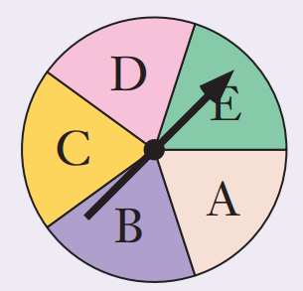


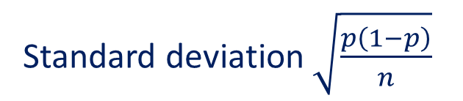


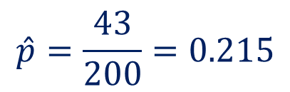
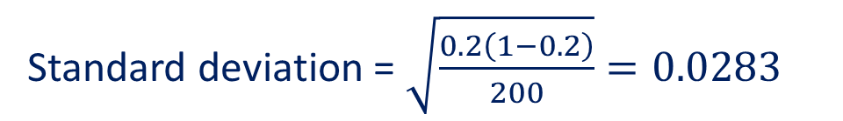

Guided Practice
When the spinner on the right was spin 200 times, an “A”
occurred on 43 occasions
What is the value of $p$, the proportion of As?
What is the value of $\hat{p}$, the sample proportion of As?
Calculate the mean and standard deviation of $\hat{p}$ for such samples of 200 spins
$$p=0.2$$
$$\hat{p}=\frac{43}{200}=0.215$$
$\hat{p}$ will have a mean equal to $p$
$$p=0.2, n=200$$
Standard deviation $\sqrt{\frac{p\left(1−p\right)}{n}}$
$$\hat{p}=0.2$$
Standard deviation = $\sqrt{\frac{0.2\left(1−0.2\right)}{200}}=0.0283$

Slide 8
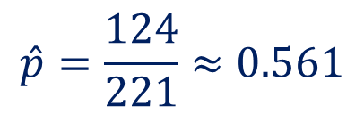
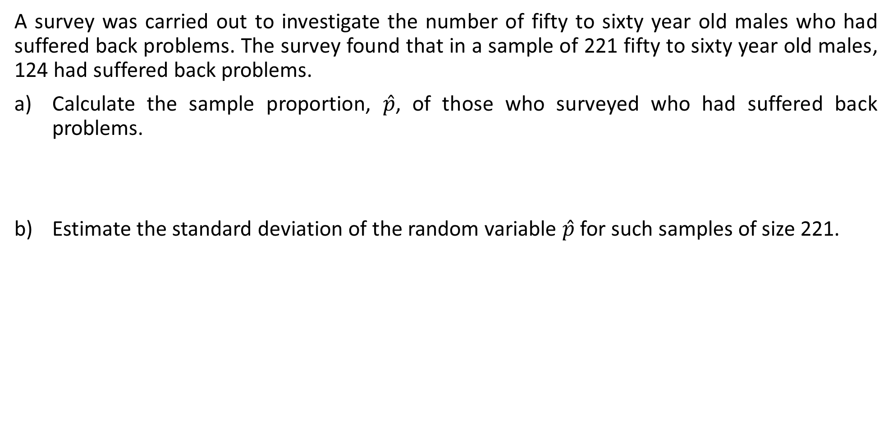
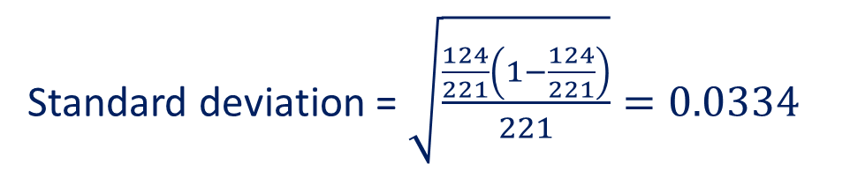

Guided Practice
A survey was carried out to investigate the number of fifty to sixty year old males who had suffered back problems. The survey found that in a sample of 221 fifty to sixty year old males, 124 had suffered back problems.
Calculate the sample proportion, $\hat{p}$, of those who surveyed who had suffered back problems.
Estimate the standard deviation of the random variable $\hat{p}$ for such samples of size 221.
$$\hat{p}=\frac{124}{221}≈0.561$$
Standard deviation $\sqrt{\frac{p\left(1−p\right)}{n}}$
Standard deviation = $\sqrt{\frac{\frac{124}{221}\left(1−\frac{124}{221}\right)}{221}}=0.0334$

Slide 9
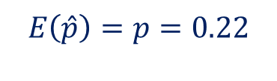


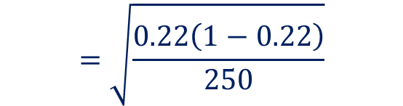
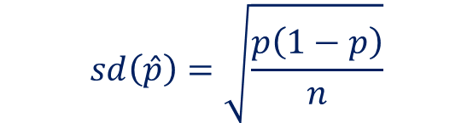
Guided Practice
It is known that 22% of males suffer from some form of colour blindness. Samples of 250 men are surveyed to determine the proportion that have some form of colour blindness. What is the expected proportion and standard deviation of the sample proportion?
Population proportion: $p=0.22$
$$E\left(\hat{p}\right)=p=0.22$$
$$sd\left(\hat{p}\right)=\sqrt{\frac{p\left(1−p\right)}{n}}$$
$$=\sqrt{\frac{0.22\left(1−0.22\right)}{250}}$$
$$≈0.026$$

Slide 10
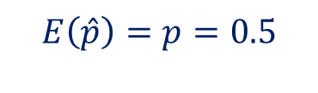

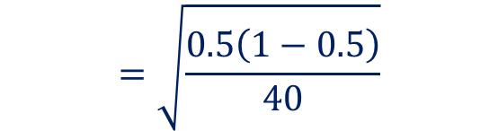
Guided Practice
A fair coin is tossed 40 times, and the number of heads recorded. The experiment is repeated many times.
What is the expected value and standard deviation of the sample proportion of heads?
Consider the theoretical probability as the Population proportion: $p=0.5$
$$E\left(\hat{p}\right)=p=0.5$$
$$sd\left(\hat{p}\right)=\sqrt{\frac{p\left(1−p\right)}{n}}$$
$$=\sqrt{\frac{0.5\left(1−0.5\right)}{40}}$$
$$≈0.079$$

Slide 11




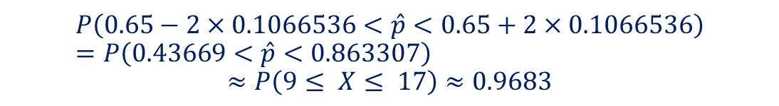

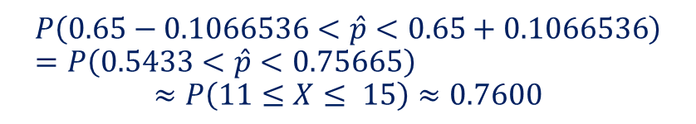
Guided Practice
Suppose that 65% of people in Australia support an AFL team. If a random sample of size 20 is chosen from this population, determine:
The probability that the sample proportion is equal to the population proportion.
The probability that the sample proportion lies within 1 SD of the population proportion
The probability that the sample proportion lies within 2 SD of the population proportion.
Population proportion: $p=0.65$
If the sample proportion is the same then $\hat{p}=0.65$
$$X\sim Bin(20, 0.65)$$
Sample size is 20, then the number of people chosen from the sample that supports this AFL team $=0.65×20=13$
$$sd\left( \hat{p}\right)=\sqrt{\frac{0.65×0.35}{20}}≈0.1066536$$
$$P\left( \hat{p}=0.65\right)=P\left(X=13\right)=\left(\begin{aligned}20 \\ 13\end{aligned}\right){\left(0.65\right)}^{13}{\left(0.35\right)}^{7}≈0.1844$$
$$P\left(0.65−0.1066536<\hat{p}<0.65+0.1066536\right) \\ =P\left(0.5433<\hat{p}<0.75665\right)$$
$$≈P\left(11≤X≤ 15\right)≈0.7600$$
$$P\left(0.65−2×0.1066536<\hat{p}<0.65+2×0.1066536\right) \\ =P\left(0.43669<\hat{p}<0.863307\right)$$
$$≈P\left(9≤ X≤ 17\right)≈0.9683$$

Slide 12
Independent Practice
Cambridge Ex 12B

